Slide 1
College is the route to move beyond minimum wage jobs

Slide 2





Meet the team
Alexander Merhige Prakriti AC Amanda Maglaras Paulina Skorupska Andrew Kwasnik

Slide 3
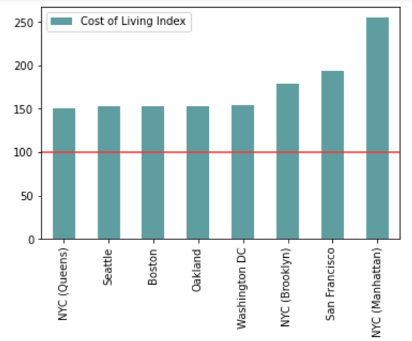
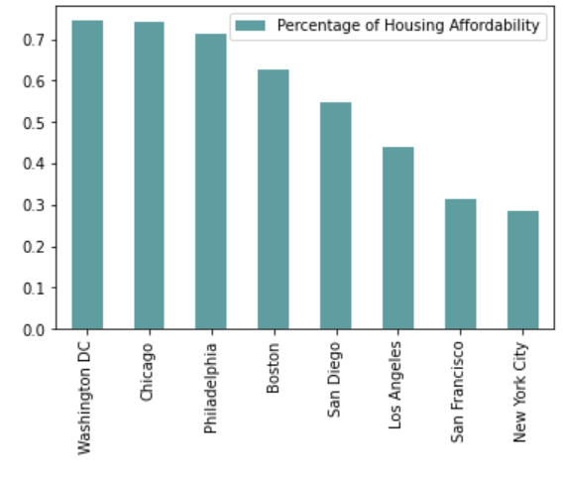
Comparing Major Cities in the U.S.
Notes:
https://www.coli.org/annual-average-2021-cost-of-living-index-released/
https://www.granitecity.illinois.gov/departments/economic_development/facts_and_figures/cost_of_living.php

Slide 4
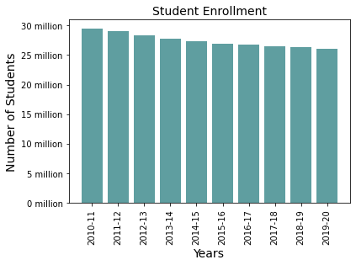
Number of students enrolled in postsecondary institutions annually
Notes:
https://nces.ed.gov/ipeds/TrendGenerator/app/answer/2/2

Slide 5
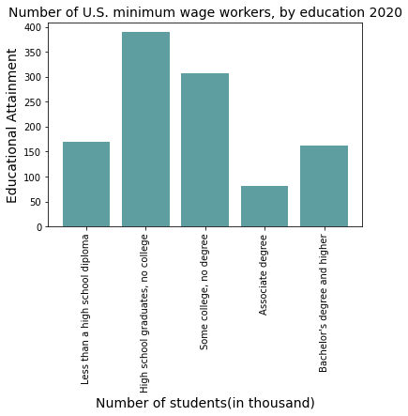
Benefits of obtaining college degree:
consistent salary
health and safety
greater life expectancy
Hourly rates with earnings at or below minimum wage in 2020
Notes:
https://www.statista.com/statistics/299395/us-minimum-wage-workers-by-education/

Slide 6
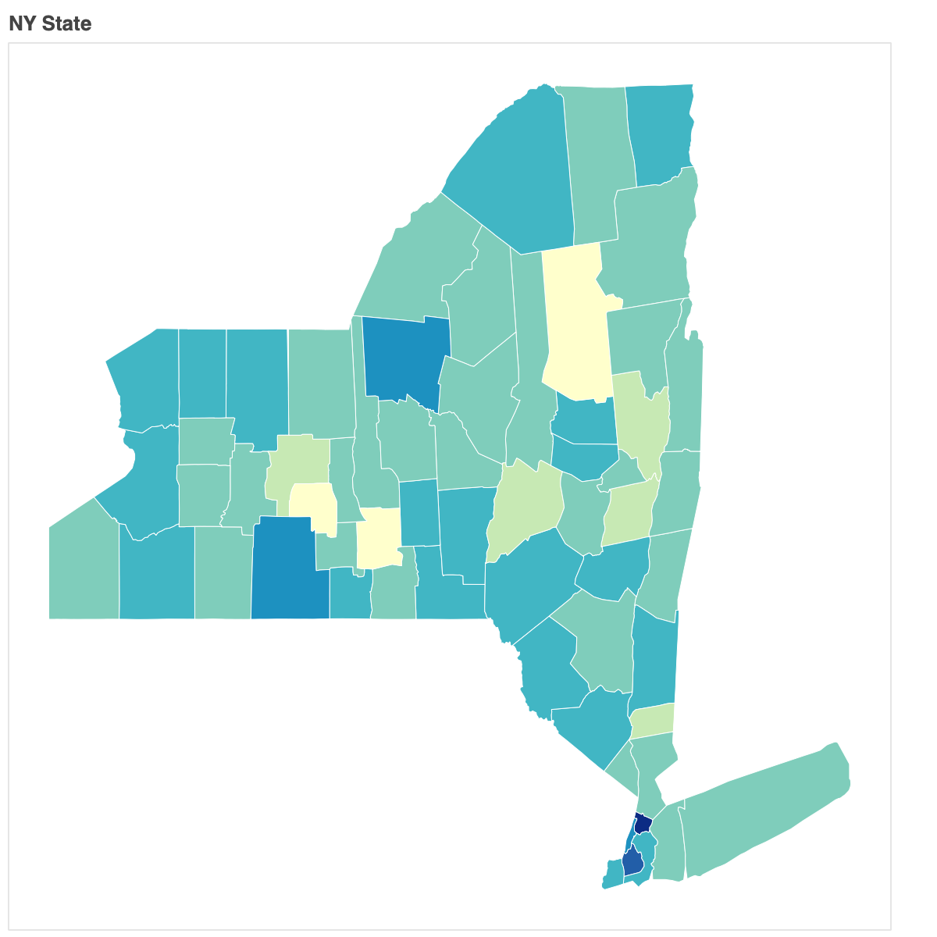
New York State’s Minimum Wage
New York’s minimum wage based on region:
NYC -Small Employers (10 or less employees)
NYC -Big Employers (11 or more employees)
Long Island and Westchester
Remainder of New York State

Slide 7
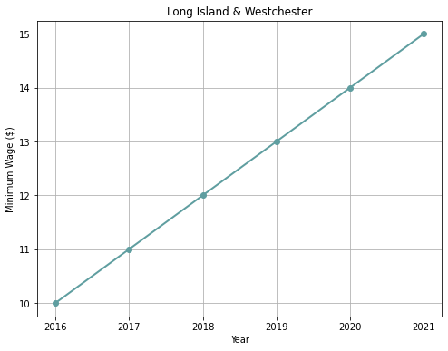
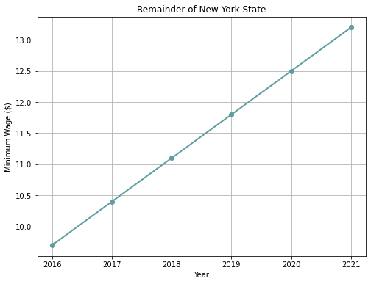
Minimum Wage Across New York
*The minimum wage is calculated on December 31 of that year*

Slide 8
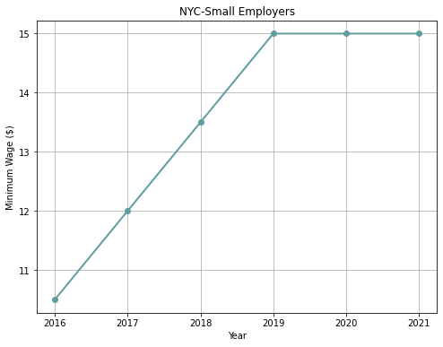
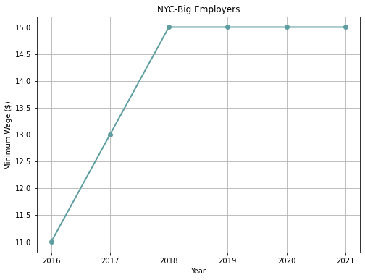
Minimum Wage In New York City
*The minimum wage is calculated on December 31 of that year*

Slide 9
What is inflation?
“Inflation is the rate at which the value of a currency is falling and, consequently, the general level of prices for goods and services is rising.”
-Investopedia

Slide 10
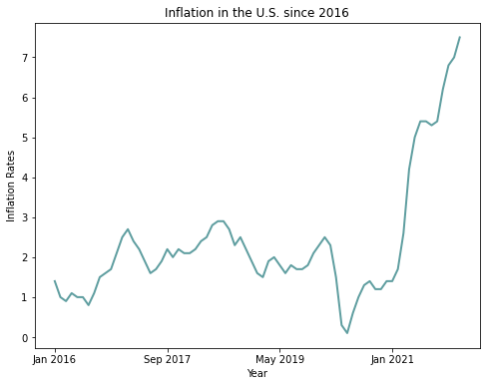
Inflation in the U.S.

Slide 11
Can you live on a minimum wage?
Notes:
https://www.nytimes.com/interactive/2014/02/09/opinion/minimum-wage.html?searchResultPosition=1&fbclid=IwAR136F0LUkCKCcMi9lQd0Z5jmYCNaPFkysH5MjLr-tN7VrS4hv5ZfgXqRLY&mtrref=l.facebook.com&gwh=A88E87E38C363F9E6C2AF0DD7F187D1F&gwt=pay&assetType=PAYWALL
https://www.numbeo.com/cost-of-living/in/New-York

Slide 12
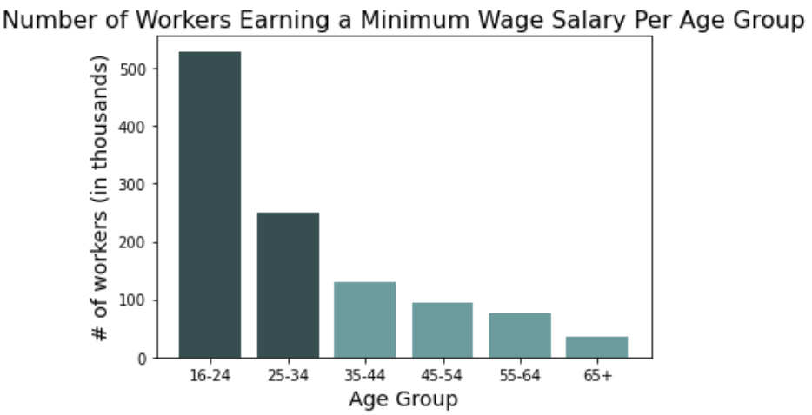
Why is this important to you?

Slide 13
Thank you!

Slide 14
Sources
https://www.coli.org/annual-average-2021-cost-of-living-index-released/
https://www.granitecity.illinois.gov/departments/economic_development/facts_and_figures/cost_of_living.php
https://nces.ed.gov/ipeds/TrendGenerator/app/answer/2/2
https://www.statista.com/statistics/299395/us-minimum-wage-workers-by-education/
https://www.statista.com/statistics/298852/minimum-wage-workers-in-the-us-by-age/
https://www.ny.gov/new-york-states-minimum-wage/new-york-states-minimum-wage
https://www.investopedia.com/terms/i/inflation.asp
https://www.usinflationcalculator.com/inflation/current-inflation-rates/
https://www.numbeo.com/cost-of-living/in/New-York
https://www.nytimes.com/interactive/2014/02/09/opinion/minimum-wage.html?searchResultPosition=1&fbclid=IwAR136F0LUkCKCcMi9lQd0Z5jmYCNaPFkysH5MjLr-tN7VrS4hv5ZfgXqRLY&mtrref=l.facebook.com&gwh=A88E87E38C363F9E6C2AF0DD7F187D1F&gwt=pay&assetType=PAYWALL

